Slide 1







MeshCentral

Slide 2
MeshCentral
{
"settings": {
"port": 443,
"MongoDb": "mongodb://127.0.0.1:27017"
}
}
{
"settings": {
"port": 443
}
}
Config.json
Config.json
./node_modules/meshcentral --dbexport bob.json
./node_modules/meshcentral --dbimport bob.json

Slide 3
MeshCentral
{
"settings": {
"port": 443,
"MongoDb": "mongodb://127.0.0.1:27017"
}
}
{
"settings": {
"port": 443,
"MongoDb": "mongodb://127.0.0.1:27017/?replicaSet=rs0",
"MongoDbName": "meshcentral",
"MongoDbChangeStream": true,
"MongoDbBulkOperations": true
}
}
Config.json
Config.json

Slide 4
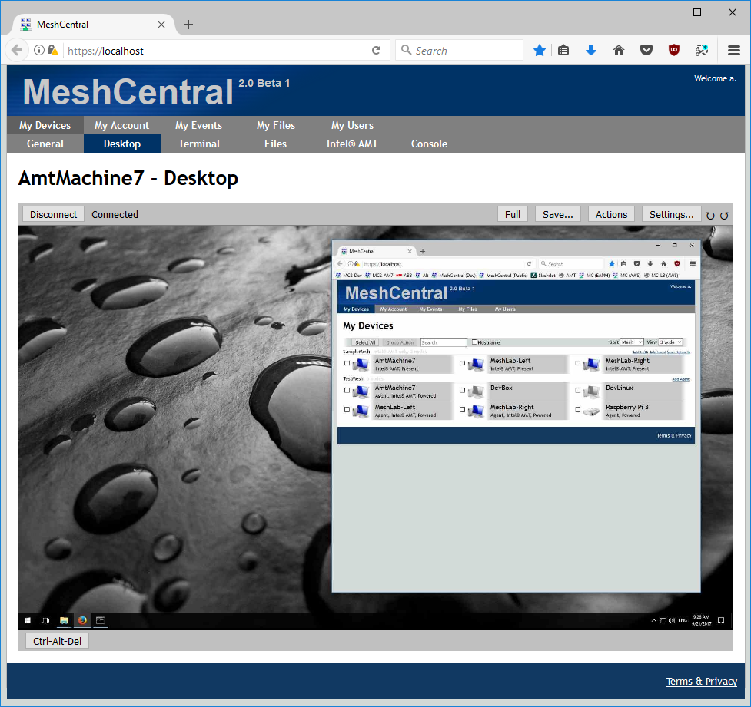
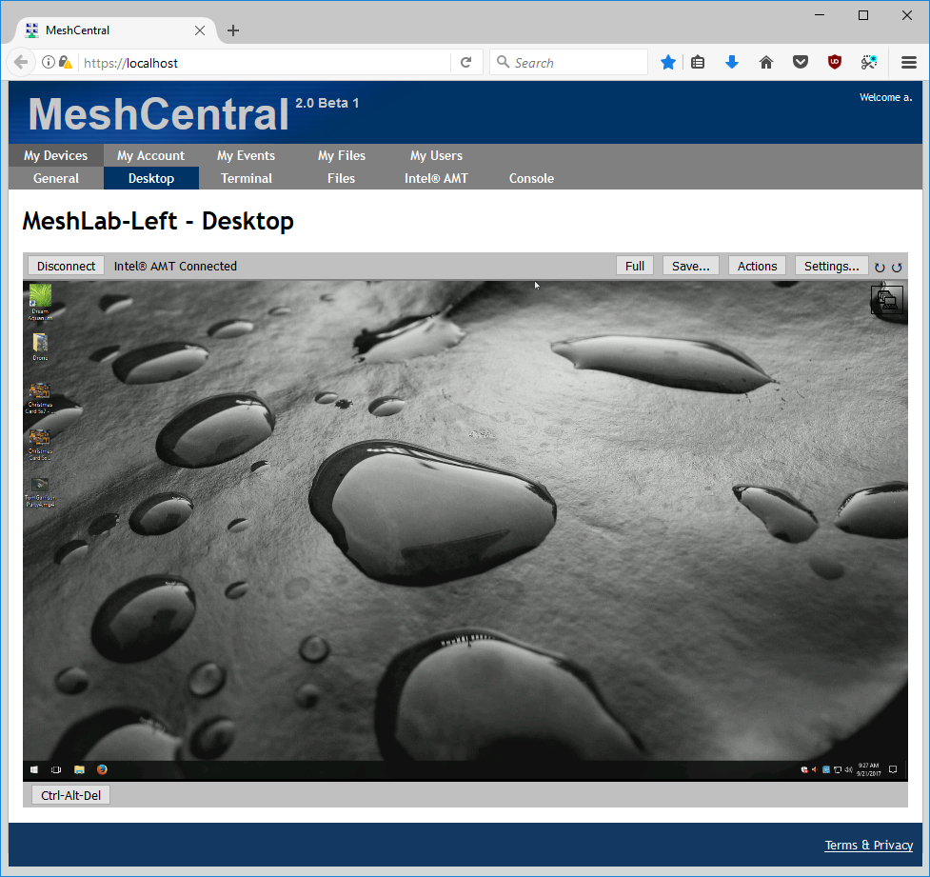
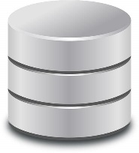






MeshCentral
MeshCentral

Slide 5

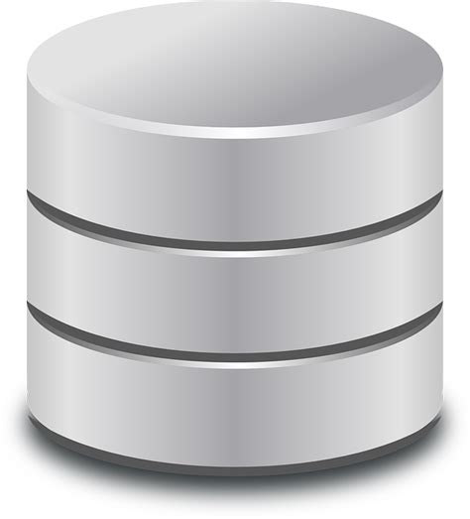
MeshCentral
WRITE
OK
WRITE
OK
WRITE 1
WRITE 2
WRITE 3
OK

Slide 6
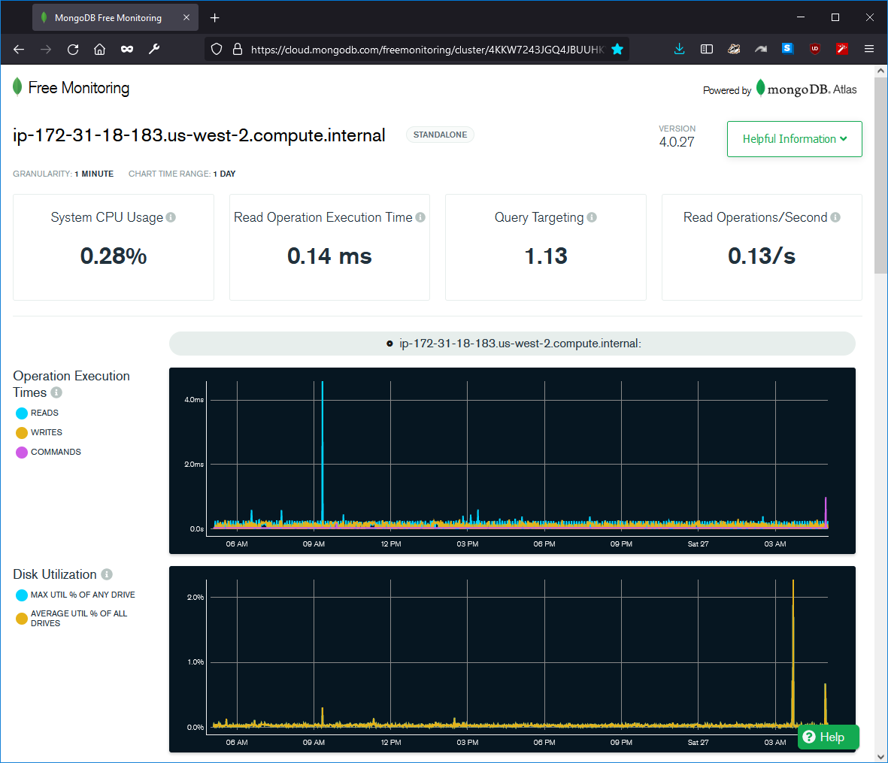

Slide 7
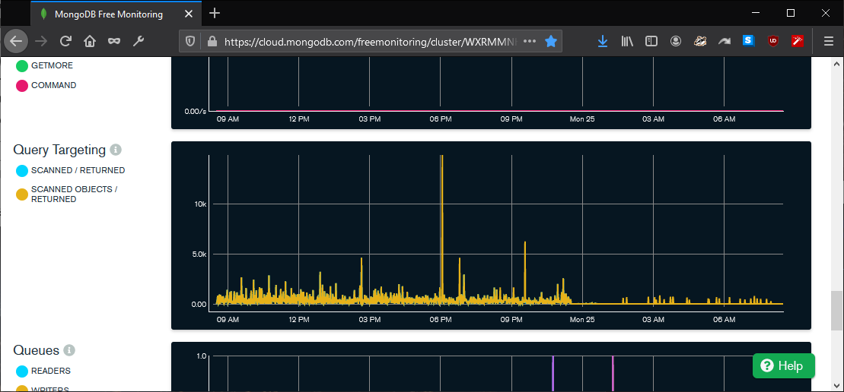
Before
After
(Lower is better)
Server update

